Slide 1
Face Tracking Mounted Gimbal
Peter Jones, Nathan Taylor

Slide 2
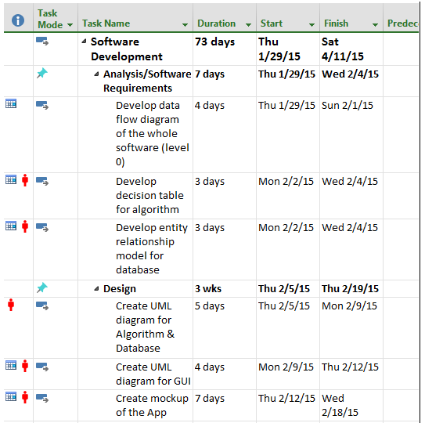
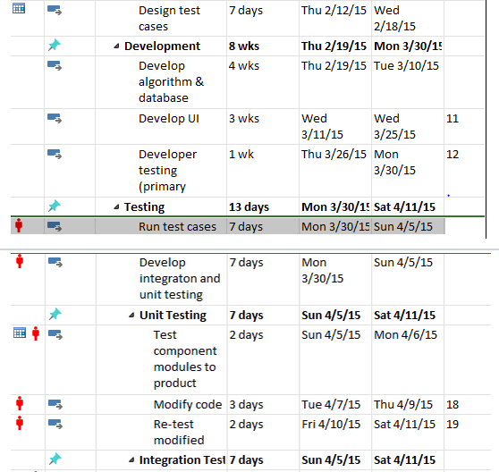
Planning

Slide 3
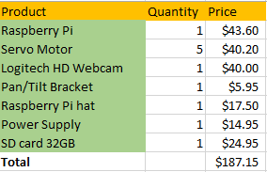
Bill Of Materials

Slide 4
Knowledge Used From Other Courses
UML and Gantt Charts from Systems Analysis
Unix System Administration and Unix Internals Helped in managing the raspberry pi environment
Data structures and algorithms helped with making the scanning algorithm
Embedded systems helped us control the servo motors
Electric circuits and digital interfacing circuits helped us troubleshoot hardware
Programming from Java/C/Assembly
Assembly for HCS-12
C for OpenCV
Java helped to understand Python
Networking Internals for socket programming

Slide 5

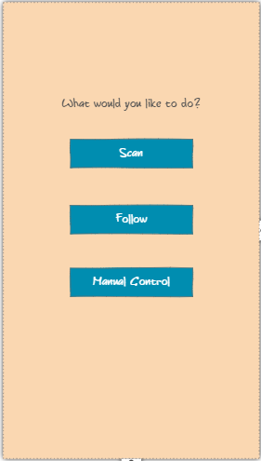
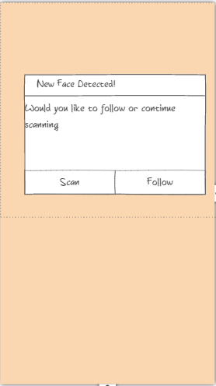

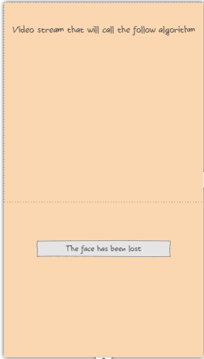
Application

Slide 6
Networking
Using Ethernet
TCP streaming using Gstreamer
Sends an image stream

Slide 7
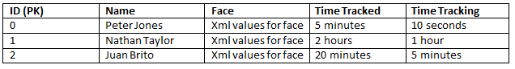
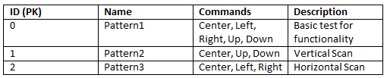
Database
Old –
New -

Slide 8
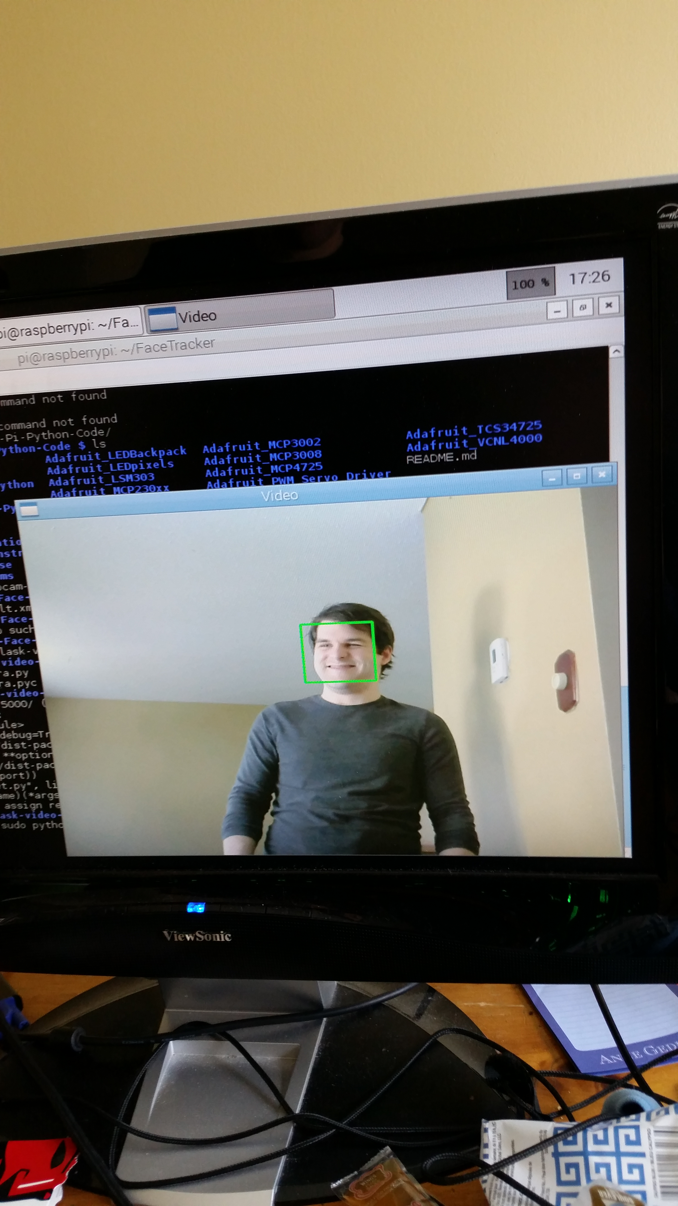
Algorithm
Limited hardware affects the face recognition
No alternatives
Analyzes 1 in 40 frames
Slow performance makes servo control difficult

Slide 9
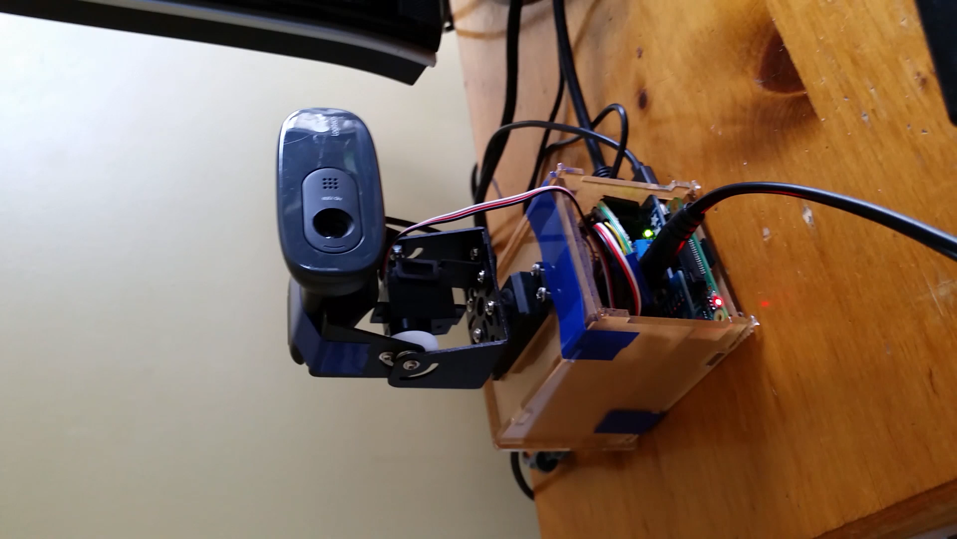
Conclusion

